Slide 1
Integral Field Spectroscopy:
Strategies and Hands-On
Themiya Nanayakkara
JWST MASTER CLASS MELBOURNE 2022

Slide 2
NIRSpec IFU Target Acquisition
About 30 min duration
Star trackers and gyros
~11” 1σ radial coarse pointing accuracy
Initial Slew to Target
5 min duration
Fine Guidance Sensor
~0.10” 1σ radial fine pointing accuracy
0.007” radial stability
Guide Star Acquisition
~8-15 minutes overhead (WATA) or about 30 min (MSATA)
~0.02” 1σ radial pointing accuracy
NIRSpec Target Acquisition
~6-8 milli-arcsec relative accuracy (radial) between dither and mosaic positions within a single visit
Science Observations

Slide 3
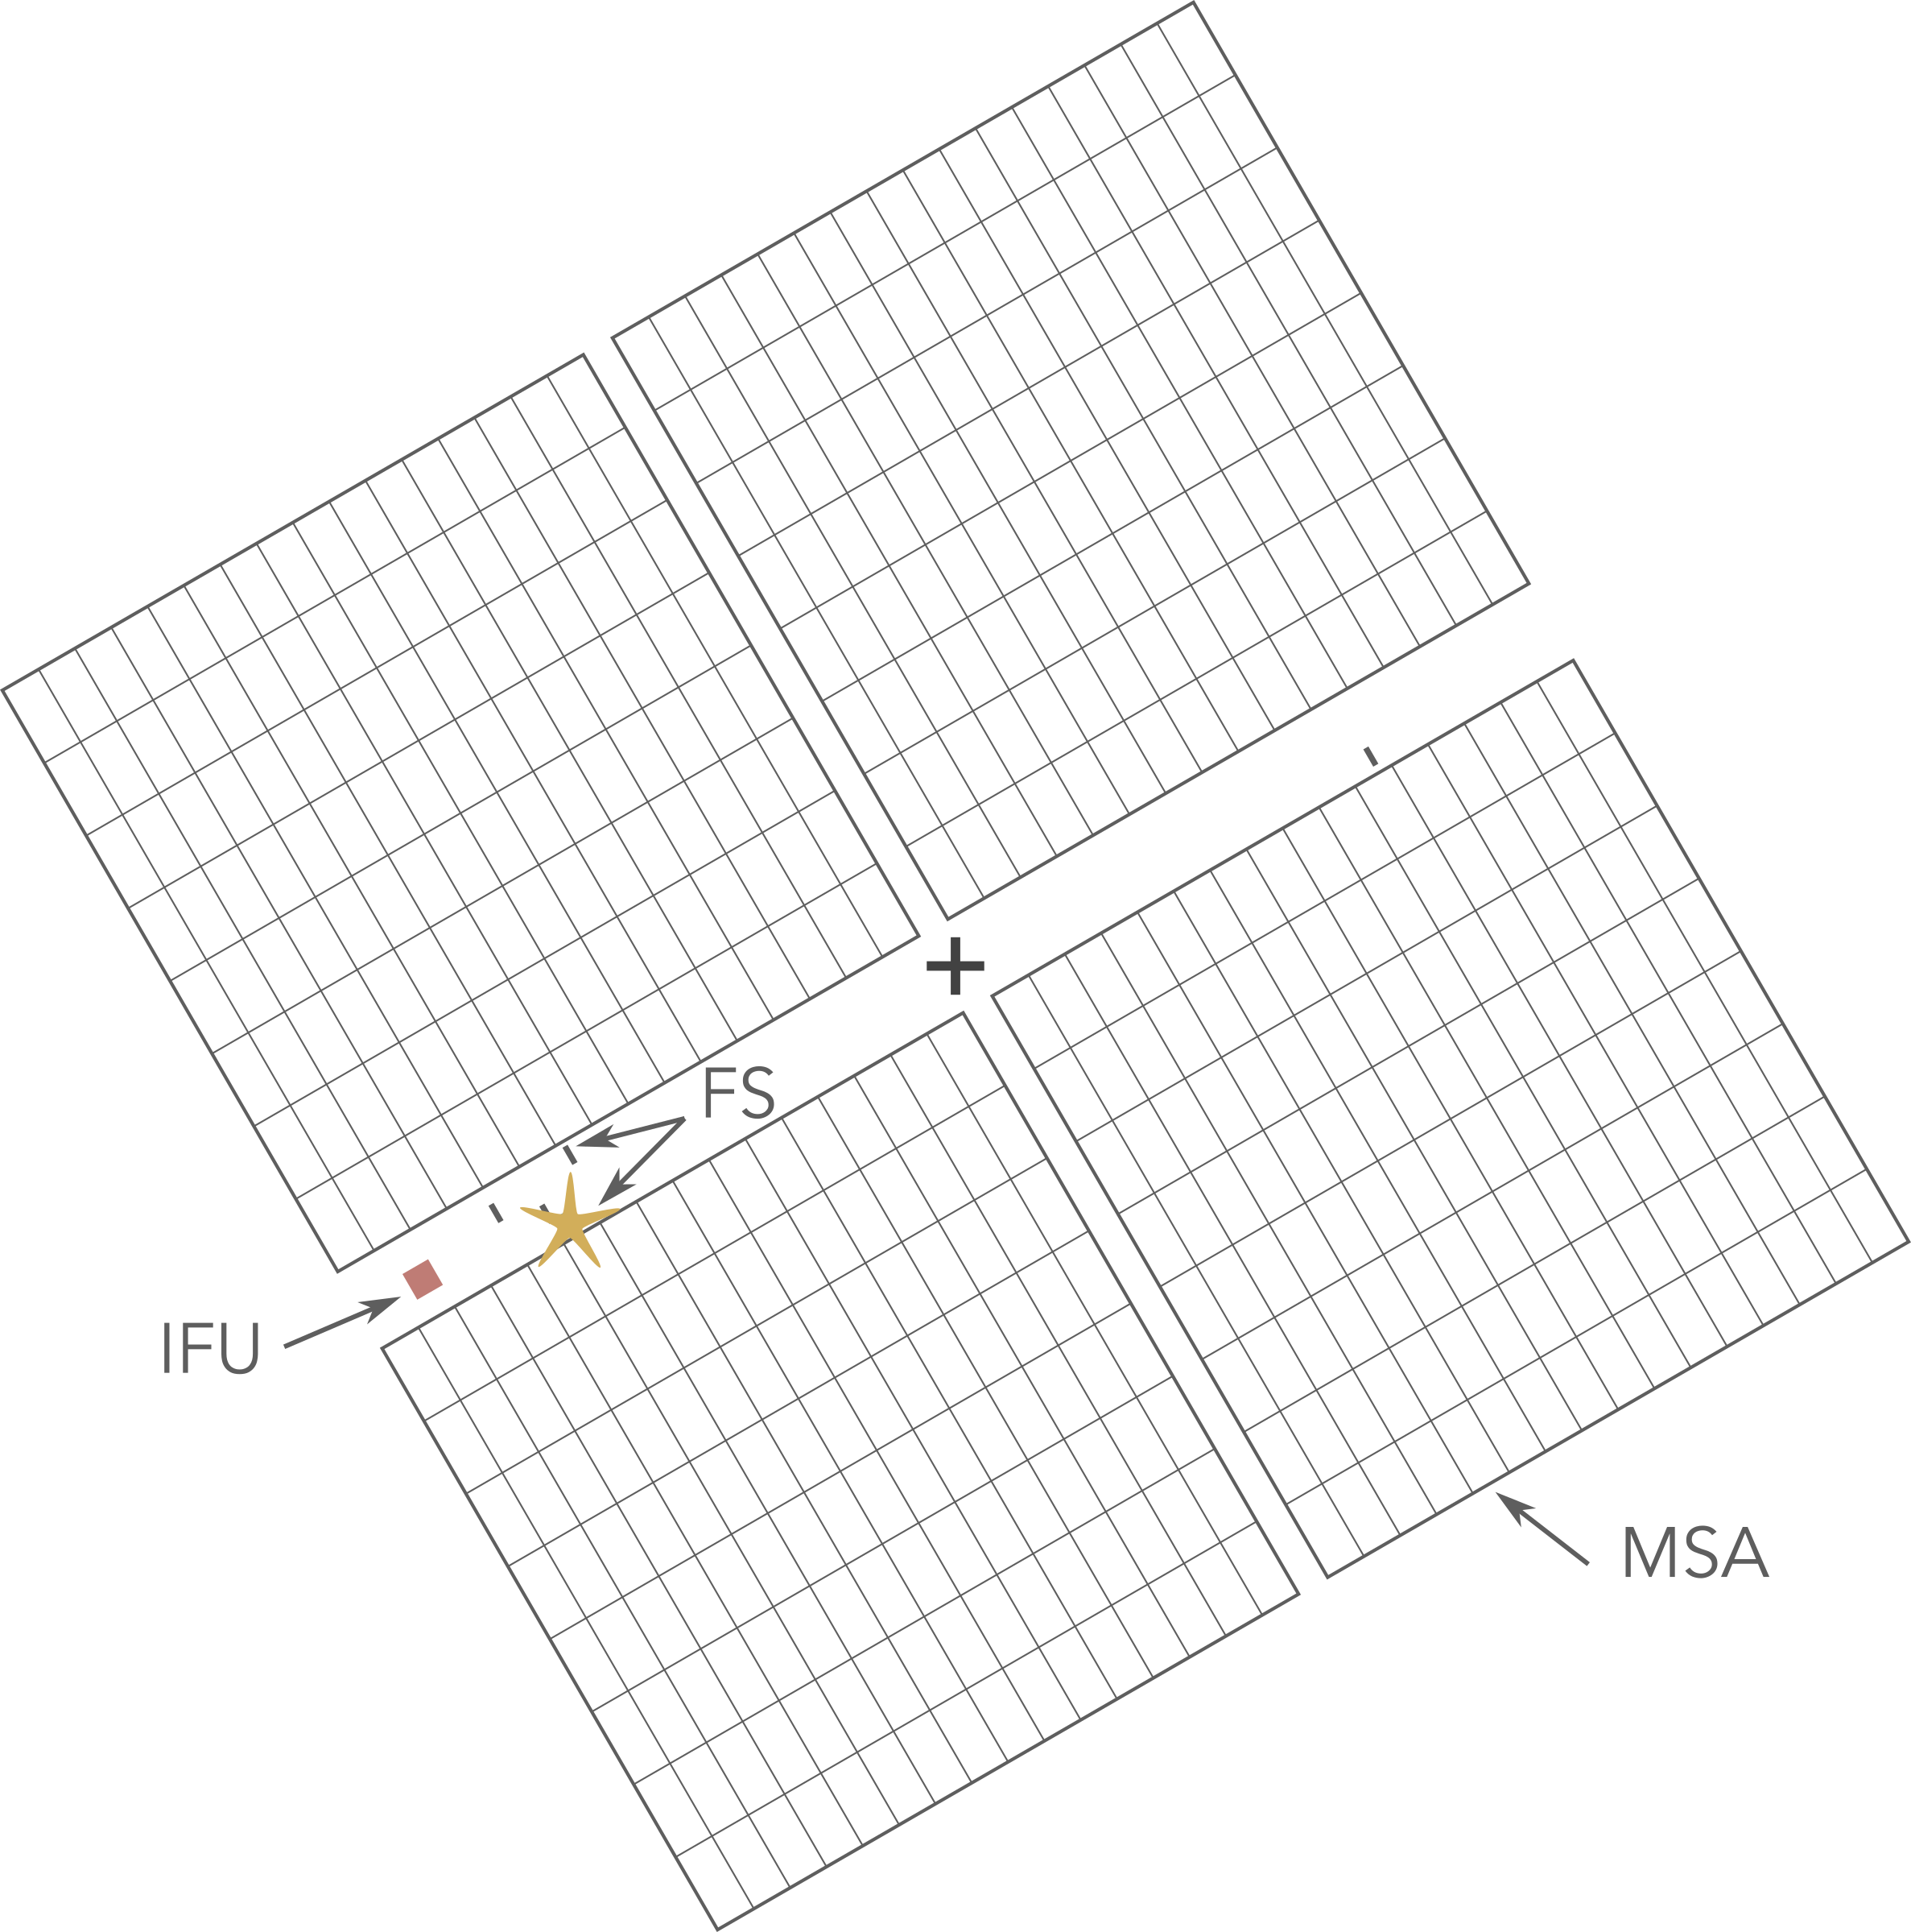
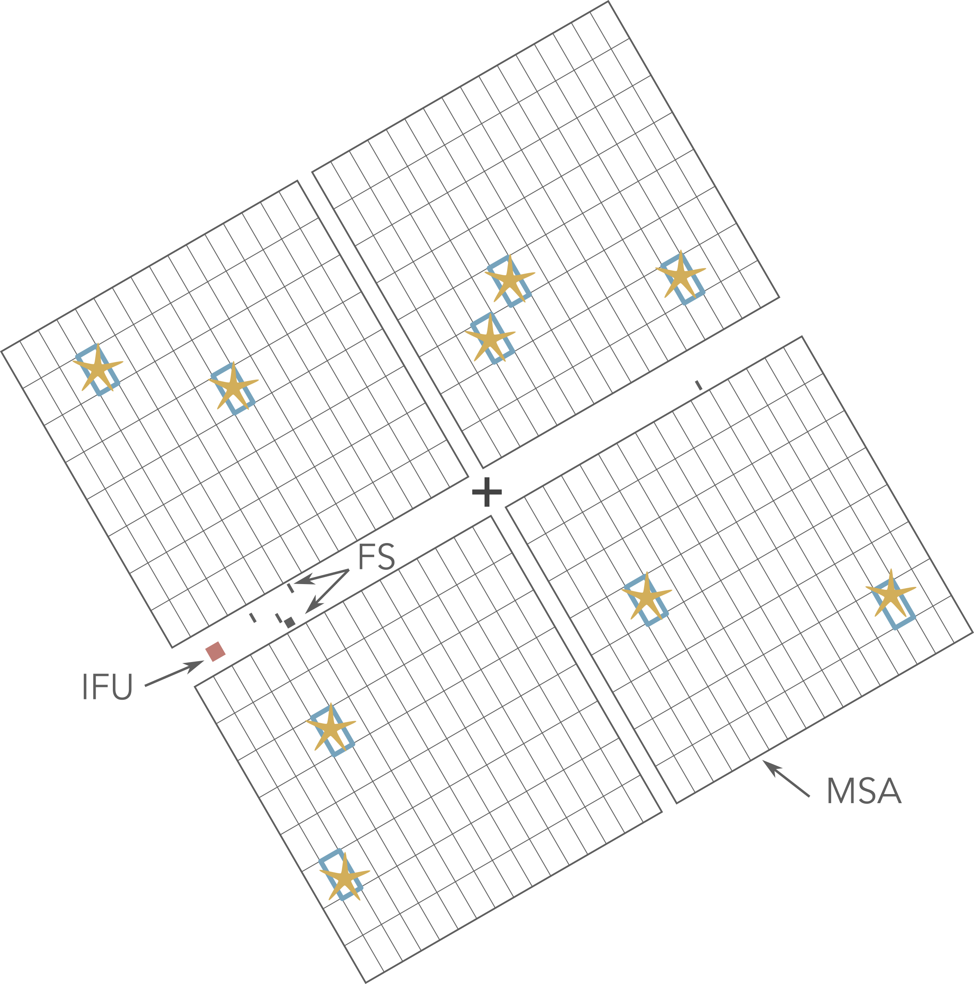
NIRSpec IFU Target Acquisition
Methods:
NONE
WATA
MSATA
VERIFY-ONLY
JWST FGS pointing accuracy (radial σ=0.10”)
Wide Aperture TA
radial σ=20 mas, 11-18 min overhead
Limited by bright (e.g. 2MASS) reference star availability
Using the MSA for TA
radial σ=20 mas, 24 –30 min overhead
Requires 8 fainter reference stars of compact sources
No TA
IFU + MSA imaging
8 –14 min overhead
Reference Star Suitability:
Ref star must not have brighter source within 2”
ref star coordinate absolute accuracy 150 mas
38” visit-splitting limitation
J = 11.9-25.7 AB mag, depending on filter and readout
recommend accurate JWST or HST pre-imaging
K = 19.5-25.7 mag, depending on filter and readout
Notes:
The default option, WATA, will suffice for most cases, but MSATA is offered when WATA is not feasible

Slide 4
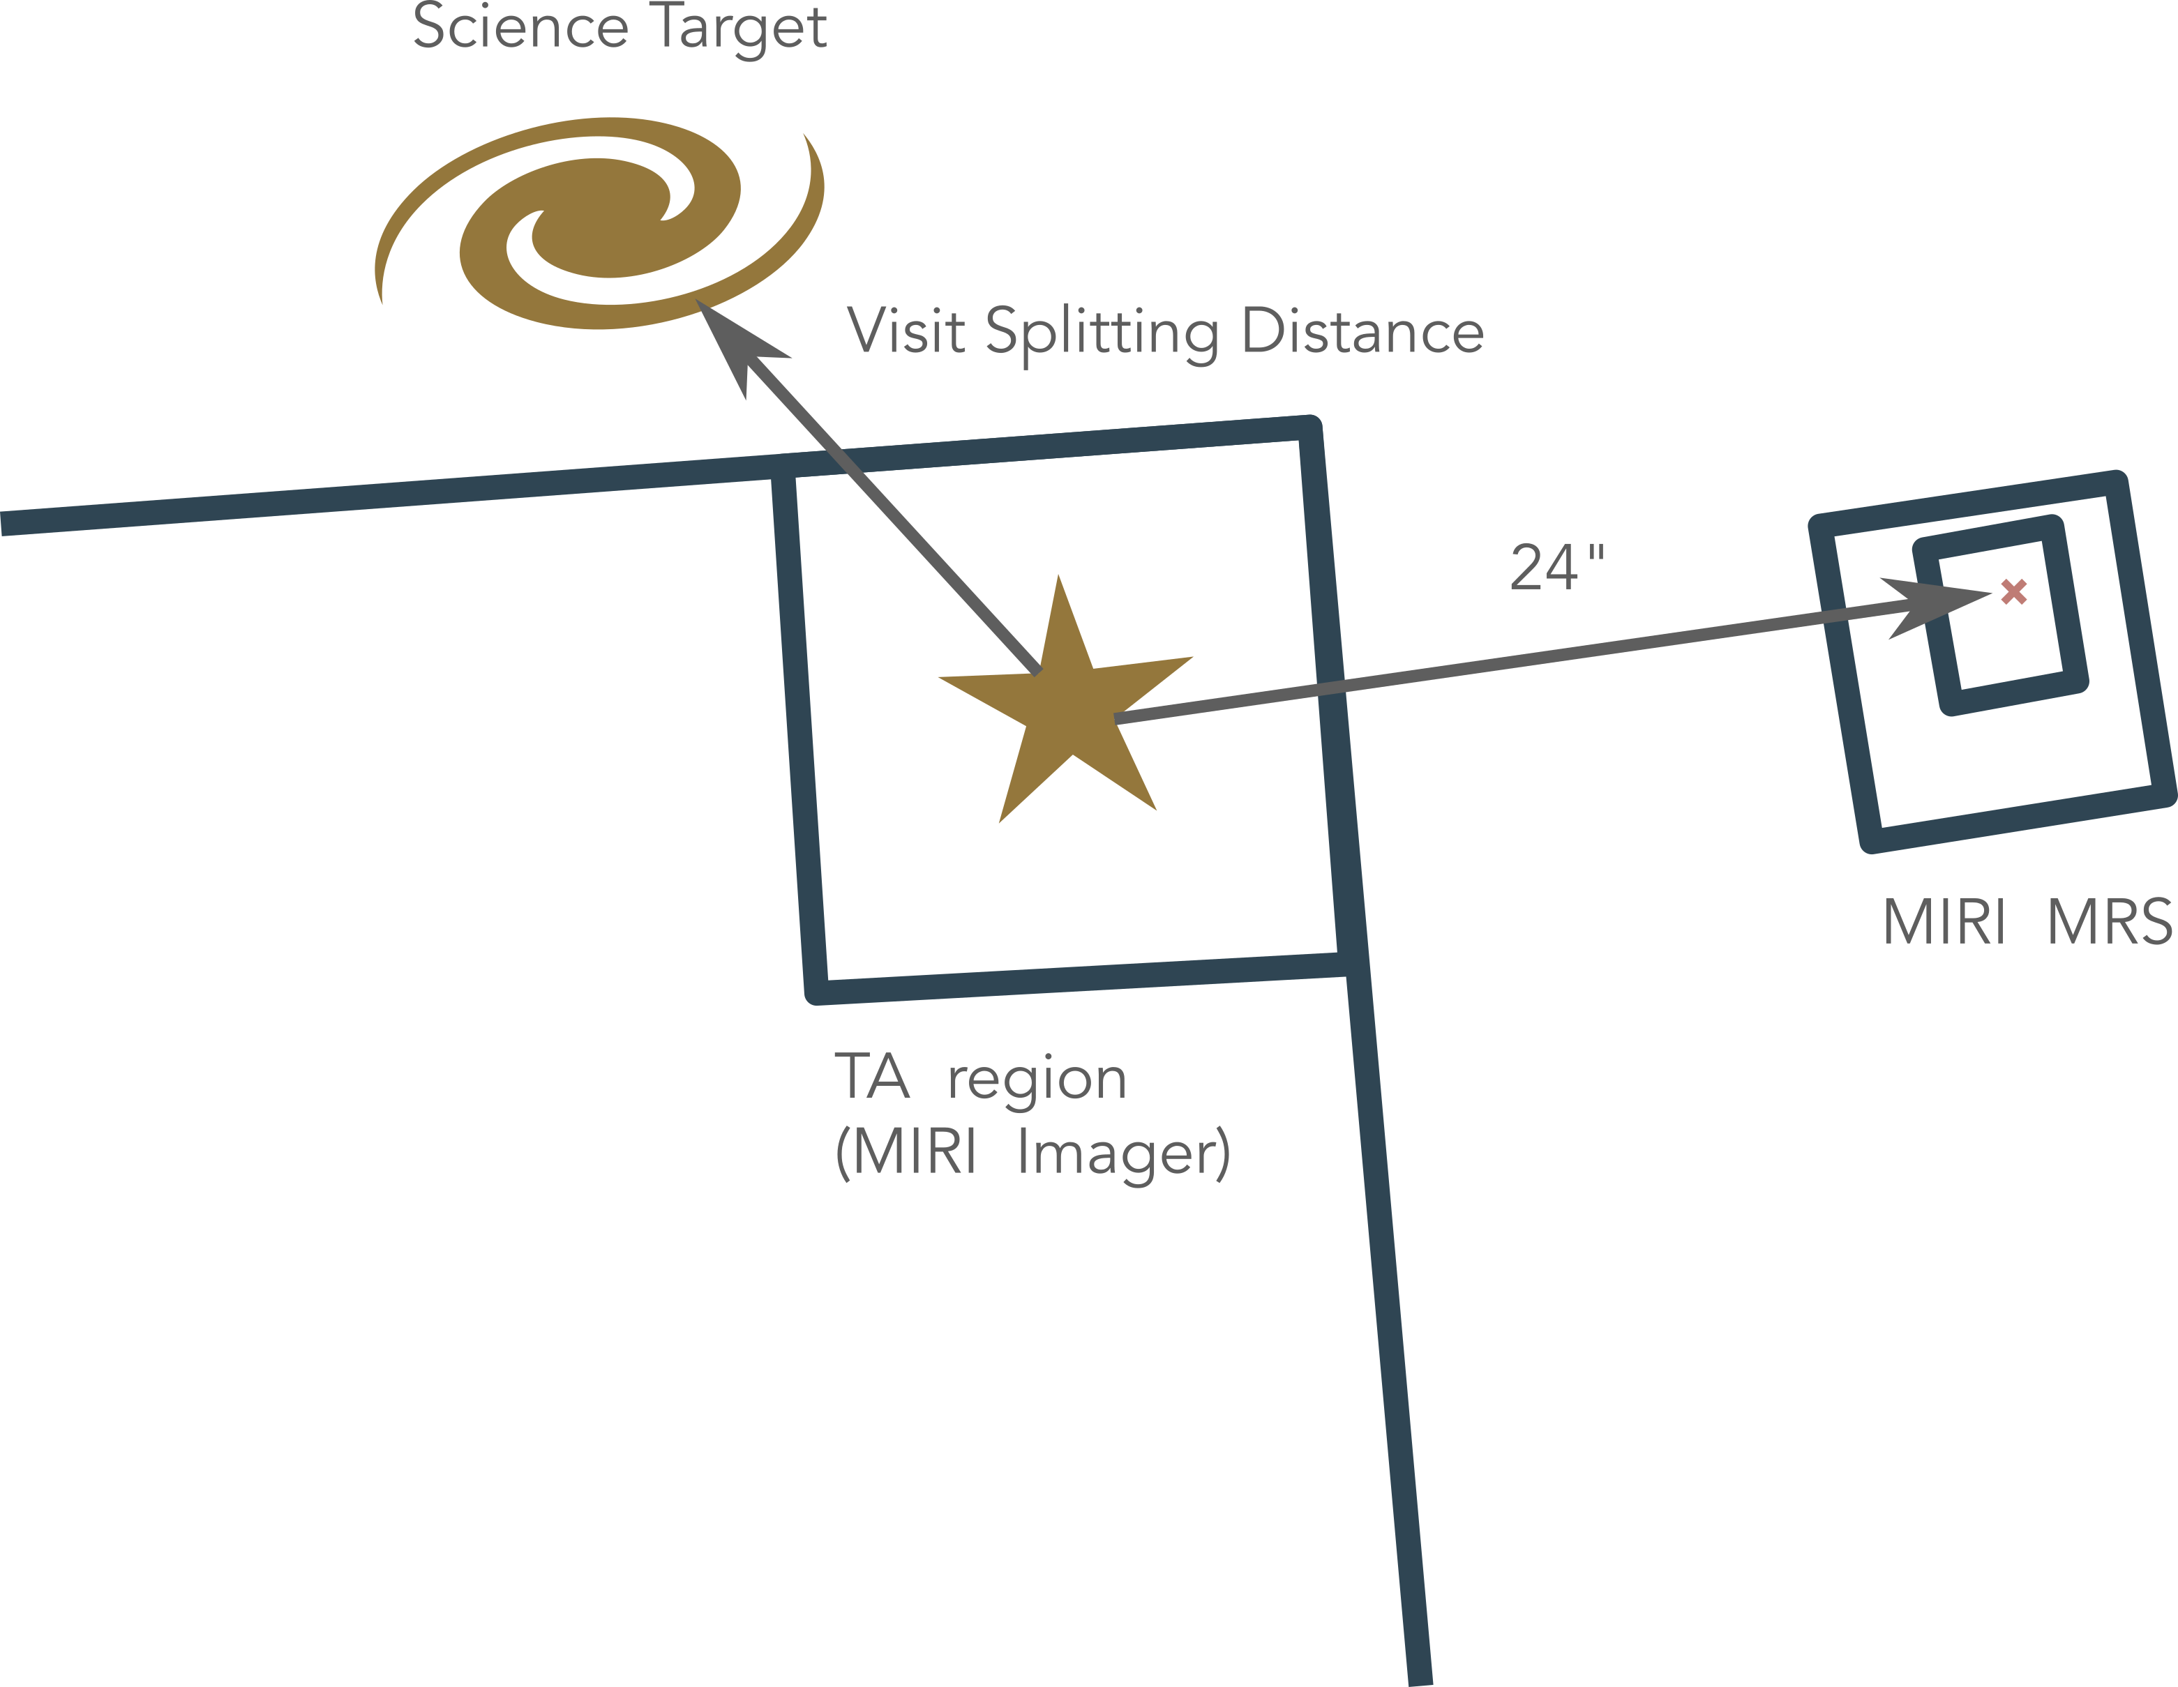
MIRI MRS Target Acquisition
Methods:
NONE
Self-TA
Offset-TA
JWST FGS pointing accuracy (radial σ=0.10”)
Wide Aperture TA
Region of interest: 48 x 48 pixel
Science target no point source/too faint.
Science target not brightest within 48x48 pixels
Reference Star Suitability:
Unsaturated (<5 Jy) point sources
Unsaturated (<5 Jy) point sources within visit splitting distance
Notes:
- if science target is not a PS or it is too faint or it has any other source within the 48 pixel (~5”) window that is brighter, then one should use offset TA
The splitting distance ranges between 30"–80", depending on the Galactic latitude of the target, and is defined as the total distance between the TA and science exposures which is the combination of:
- The distance between the TA target and science target.
- The distance between the TA aperture and the science aperture.
If the TA target is not within this visit splitting distance, the observation will not be schedulable by the APT Visit Planner. Users are encouraged to check whether their program can be scheduled when using off-source TA targets.
If feasible, using an offset TA target should be considered in the following scenarios:
The science target is spatially resolved, resulting in a higher uncertainty on the centroid location (see section below).
The science target's spectral energy distribution is not well know in the MIRI TA filters, leading to an uncertain estimation of the exposure time and SNR.
The science target requires a long (~100 s or longer) integration to reach SNR of 20.

Slide 5
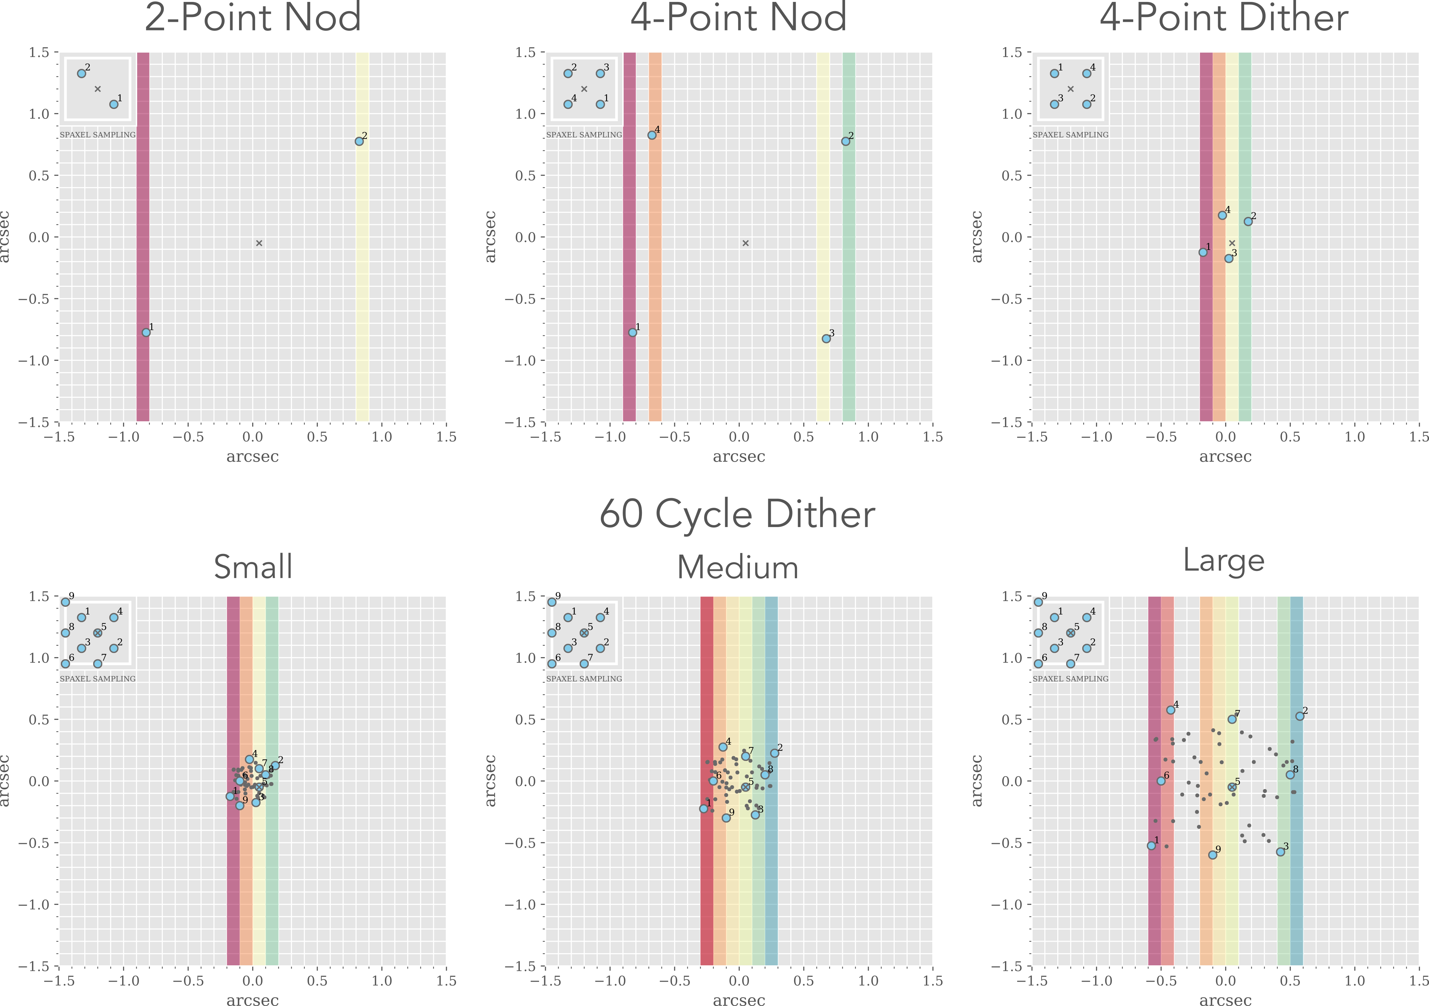
NIRSpec IFU Dithers
Nod: large offset for point/small source separation, used by pipeline to subtract background
2-point nod
1.6” in X and Y (point source separation)
4-point nod
1.6” box (separation and dithering)
TA recommended so nod remains in-scene
Dither: small offset for detector defect mitigation and better sampling
4-point dither
0.4” box
Cycling: For PSF and detector sampling
Cycling (1-60 point pattern)
First 9 points resemble a 9-point dither pattern, after this it is random
Small, Medium or Large spacings
Sparse Cycling (1-60 point pattern)
User can choose specific points from pattern
Small, Medium, or Large spacings

Slide 6
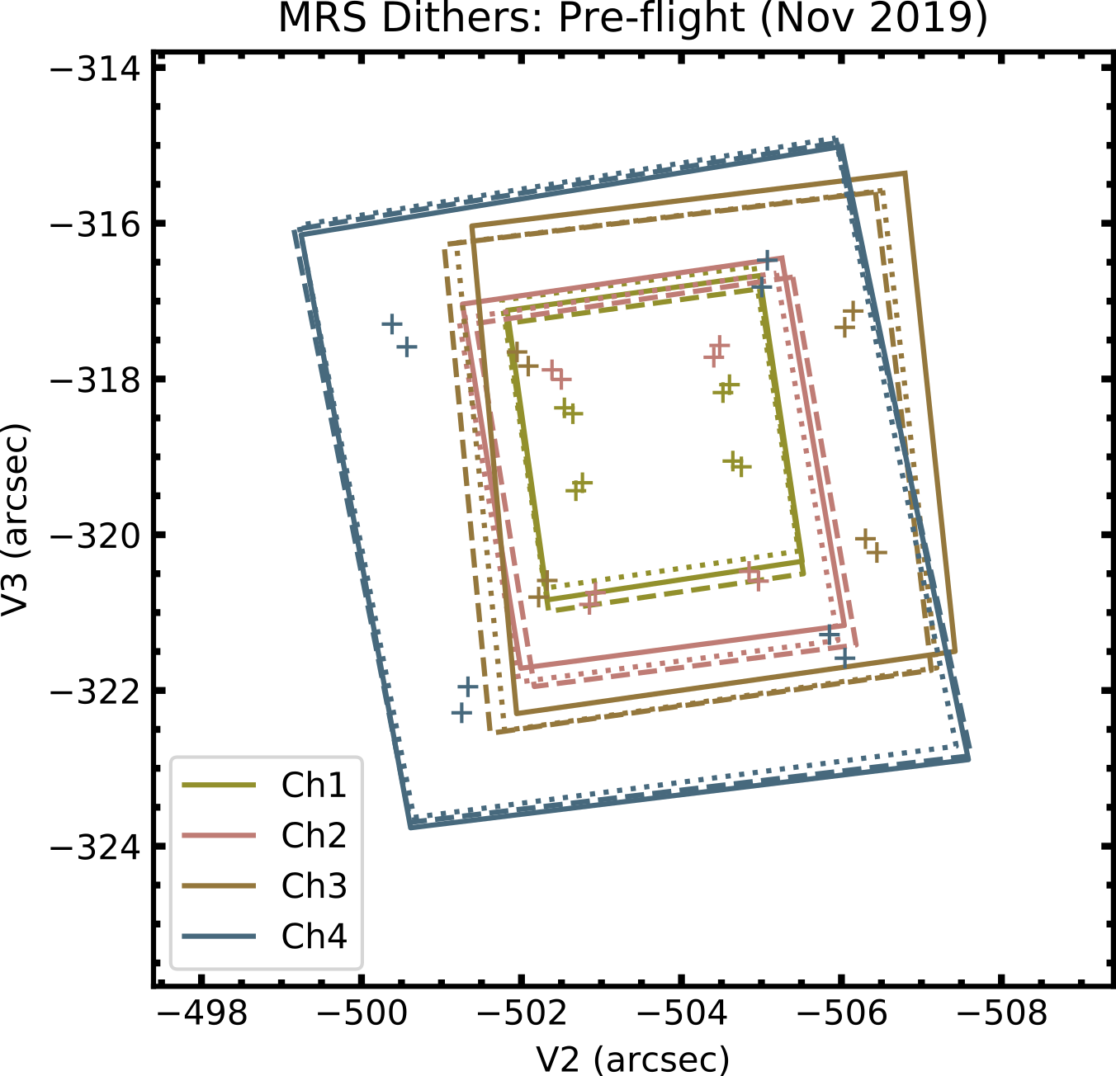
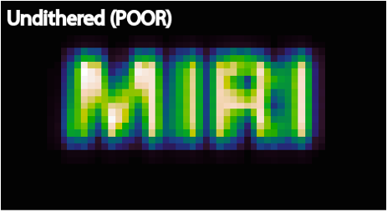
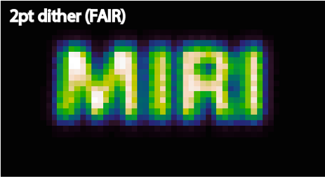
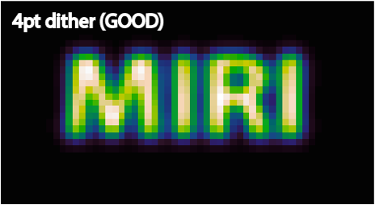
MIRI MRS Dithers
All MRS observations benefit from dithering
MIRI is a factor 2 spatially under sampled
Pattern determined by Primary Channel and Point or Extended source selection in APT
Primary: Ch4 dither will move source out of Ch1 FOV!
Direction (Positive or Negative) rotates pattern 43º for Point source
2-pt dither pattern
4-pt dither pattern
4-pt ALL preferred for point or extended sources
Notes:
in APT one can specify which is the primary channel. The dither pattern is then defined by this. There is also the option ALL (so that it fits into all channels) but that is the same as Channel 1 (since this is the smallest one)
There are two different directions, positive and negative and they rotate the pattern
In pricinple one could have 8 dither points with this if one chooses the four point dither pattern in both directions
If one chooses channel 4 as primary channel this will move the target out of channel 1

Slide 7
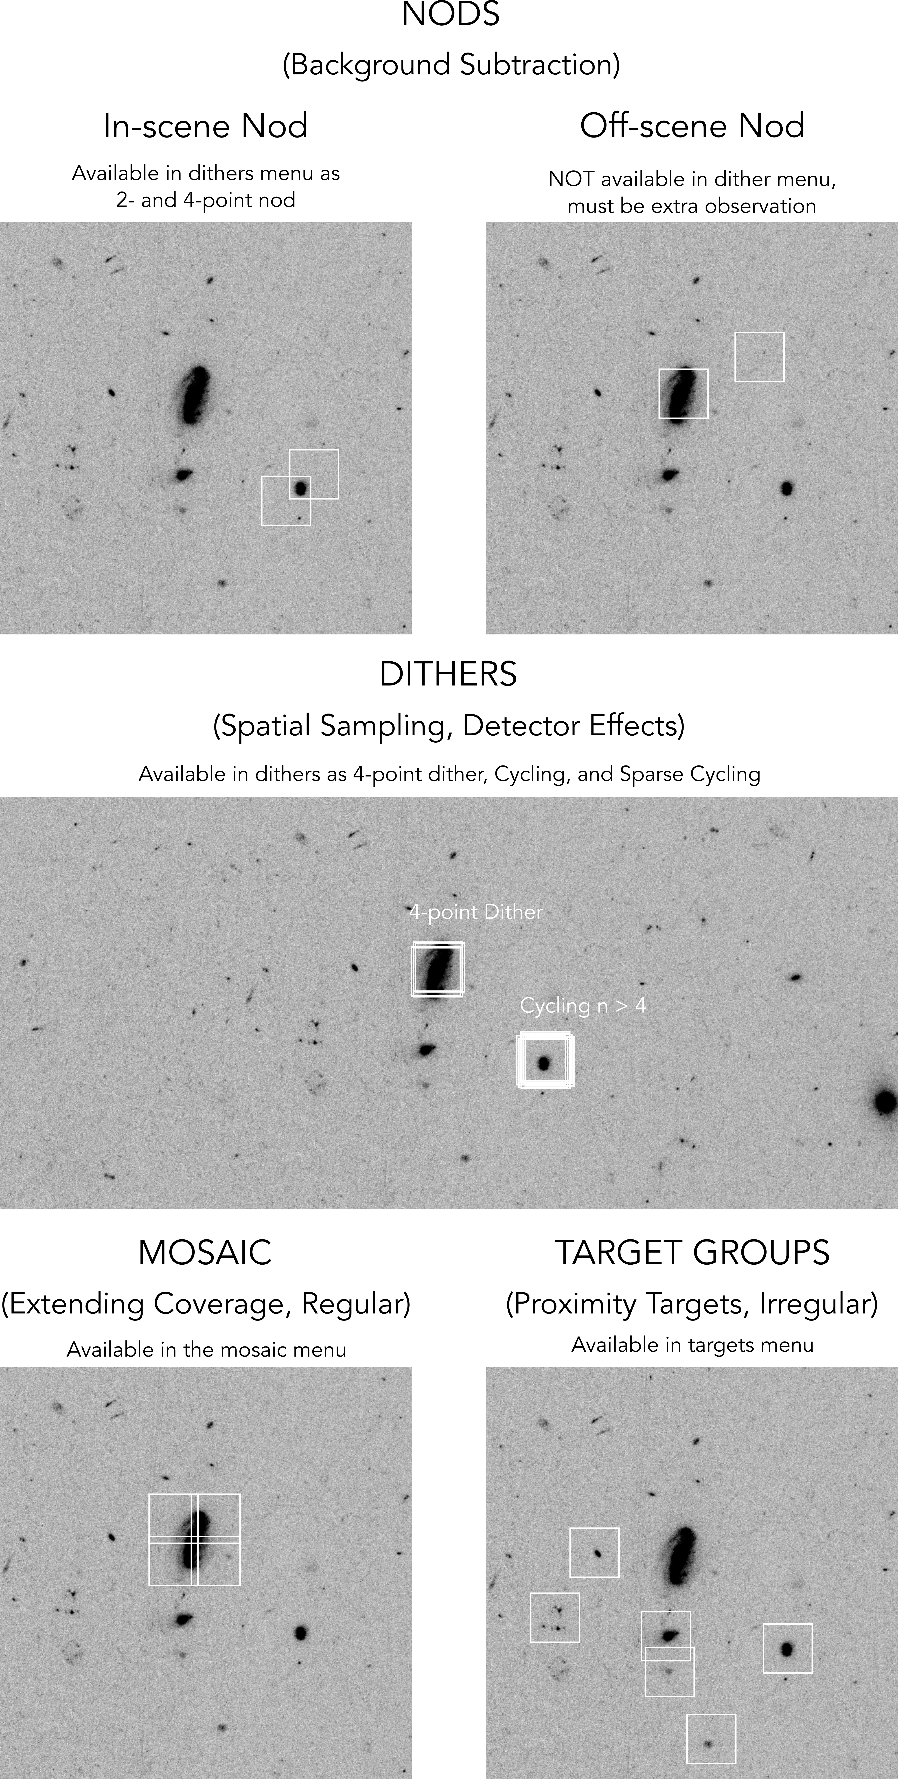
Mosaics and Target Groups
Mosaics
Small region
Regular pattern
Overlap or no overlap
May be used for backgrounds
Target Groups
Multiple, linked pointings
Stay within visit-splitting distance
Defined observations are replicated on each target
Useful for offset backgrounds

Slide 8
Offset Background Observations
NIRSpec IFU
Not all observations require offset backgrounds. Check with ETC
Offset backgrounds suggested for:
Faint extended targets
Use target groups or mosaic within visit-splitting distance to avoid variable background and non-repeatable grating settings
MIRI MRS
Most extended source observations require offset backgrounds. Check with ETC
Isolated point source observations may not require offset backgrounds

Slide 9
NIRSpec IFU Exposure Parameters
READOUT
IRS²
NRSIRS2 (5 frames per group) reduce data volume
NRSIRS2RAPID (1 frame per group) recommended
TRADITIONAL
NRS (4 frames per group)
NRSPRAPID (1 frame per group) for bright sources
GROUPS
2 or more recommended for accurate calibration
INTEGRATIONS
<1500 sec recommended to mitigate cosmic rays
EXPOSURES
Number must be the same for all detectors
No explicit limit on exposure time

Slide 10
MIRI MRS Exposure Parameters
READOUT
SLOW mode
Fewer detector artifacts and slightly lower noise
Limits data rate when including NIRIM or parallels
FAST mode
Current default for MRS (except when data volume is an issue)
Available for bright targets
May be advantageous for expected high CR-rates (stay tuned)
GROUPS
5 or more recommended for calibration
INTEGRATIONS
1 integration recommended to maximize groups and best slope fitting (except for bright targets and high background, then multiple integrations are beneficial)
<1000 sec recommended due to expected cosmic rays
EXPOSURES
Number must be the same for all detectors

Slide 11


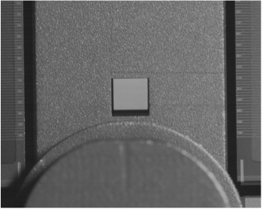
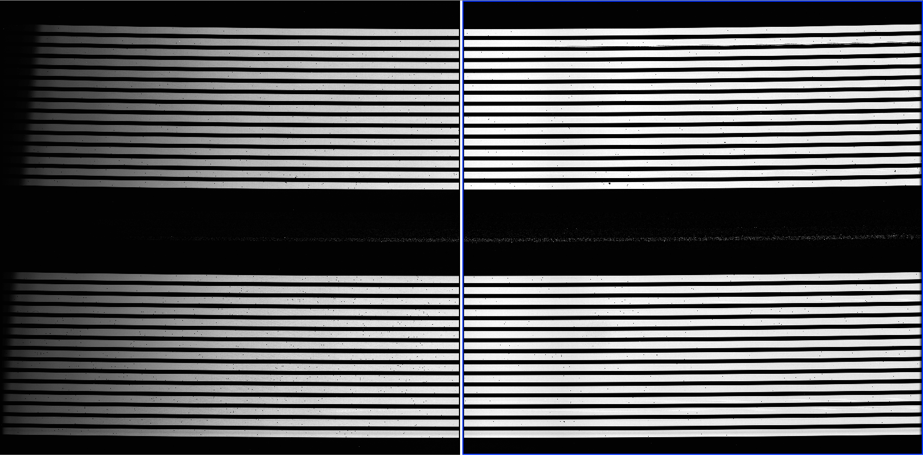
NIRSpec Leakage
IFU observations may be affected by MSA light leaks
Stars in open MSA shutters or bright star print-through
Print-through from diffuse backgrounds (<3-10%)
Solution: Leakcal Observation - extra exposure with the IFU closed
Guidance on when Leakcal observations are necessary
Depends on source vs spoiled signal
Print-through important for stars >500x brighter than target
Crowded stellar field
Bright structured background (e.g. nebulae)
Mitigation Strategies
Orient constraints
Dithering (at 4 or more points) to reject stellar leaks
Single Leakcal at one position to remove diffuse leakage
Full set of Leakcals at every pointing is expensive
Full or shorter exposure

Slide 12
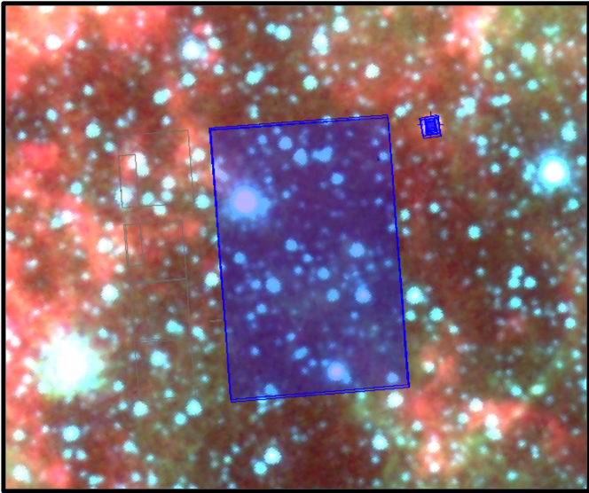
MIRI MRS Simultaneous Imaging
Default operational mode for the MRS, not a parallel imaging mode.
Why is it useful?
Improved the astrometric accuracy of the MRS observation
Used to obtain additional science observations in an adjacent field of view
Should only be turned off if there are very bright targets in the imager field of view
Simultaneous imaging will not be available for the MRS time series observations

Slide 13
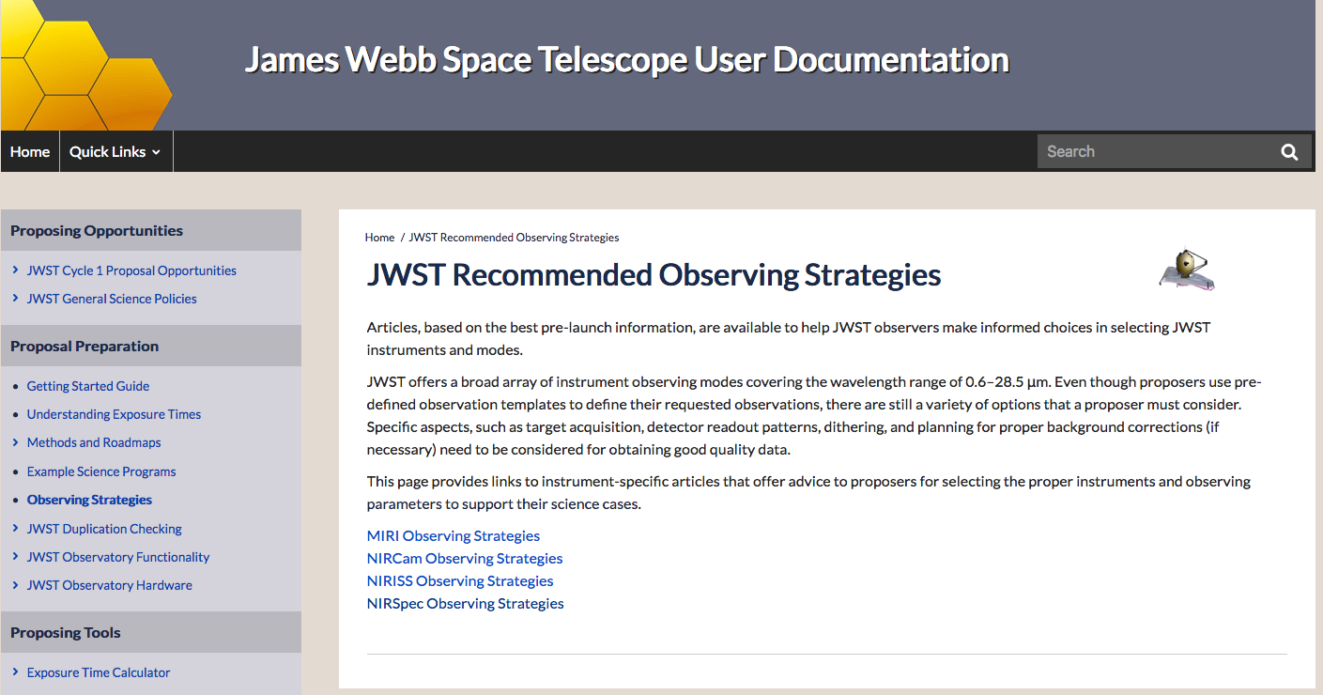
Need help making a decision?
Several decision processes are described in the J-Dox:
https://jwst-docs.stsci.edu/jwst-recommended-observing-strategies

